Slide 1
Summer Internship on A Statistical Study of Road Accidents in Various States in India
Shivam Gupta
M.Sc. Data Science
A044161824015
Faculty Guide: Dr. Vaidehi Singh
1

Slide 2
CONTENTS
Introduction
Objective
Methodology
Exploratory Data Analysis
Predictive Modelling
Results and Interpretation
Conclusion
References
2

Slide 3
Introduction
Road accidents are a serious public safety and infrastructure challenge in India, causing over 150,000 deaths annually. Key causes include human errors like over speeding and drunk driving, vehicle faults, and poor road conditions. Environmental factors such as weather and visibility further increase risks. This project aims to analyze accident data using statistical and machine learning techniques to identify patterns, predict accident severity, and provide insights for improving road safety measures.
3

Slide 4
OBJECTIVE
To perform a Statistical Study of Road Accidents in Various States of India by analyzing patterns and contributing factors.
Utilize Descriptive Statistics to explore differences in accident characteristics (mean, percentage, ratios) across states.
Implement Machine Learning Models (Logistic Regression & Random Forest) to predict Accident Severity (Fatal vs Non-Fatal).
Provide actionable insights to help traffic authorities identify high-risk zones and suggest data-driven safety interventions.
4

Slide 5
Methodology
Data Collection: Road accident dataset sourced from Kaggle, covering various states of India.
Data Preprocessing: Handling missing values, outlier detection, and data cleaning to ensure quality.
Exploratory Data Analysis (EDA): Statistical summaries and visualizations to identify patterns in accidents based on factors like state, vehicle type, road condition etc.
Feature Selection: Identifying key variables influencing accident severity.
Model Building: Applying Logistic Regression and Random Forest Classifier to predict accident severity (Fatal/Non-Fatal).
Model Evaluation: Comparing models using accuracy, precision, recall, F1-score, and confusion matrix to select the best-performing model.
5

Slide 6
Exploratory Data Analysis
6

Slide 7
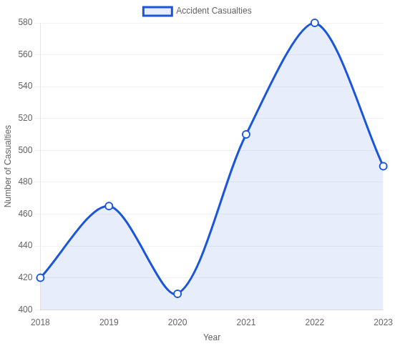
Accident Trend (2018-2023):
Time-series analysis shows significant fluctuation in accident rates and casualties over the 6-year period.
Steady increase observed from 2018 through 2021, with minor variations
2022 marked the peak year with highest recorded casualties and accidents
Notable improvement in 2023 with reduced accident frequency and severity
7

Slide 8
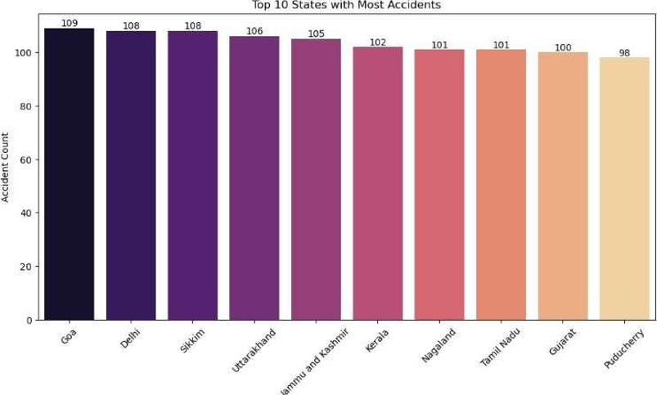
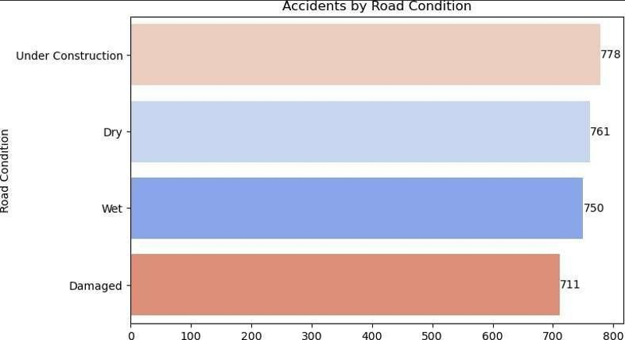
States/UTs with the Highest Number of Accidents
Goa, Delhi, and Sikkim reported the highest number of accidents.
Smaller states like Uttarakhand and Nagaland are also highly affected.
Key factors: Tourist traffic, hilly terrains, and poor road infrastructure.
Accidents are widespread, impacting both urban and remote regions.
Accidents by Road Condition
Under Construction roads account for the highest accidents due to poor traffic management.
Dry and Wet roads show high accident counts, linked to slippery conditions.
Damaged roads (potholes, cracks) significantly contribute to accident risks.
8

Slide 9
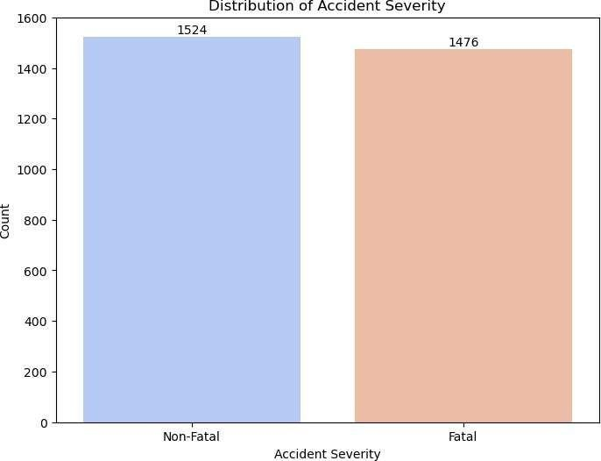
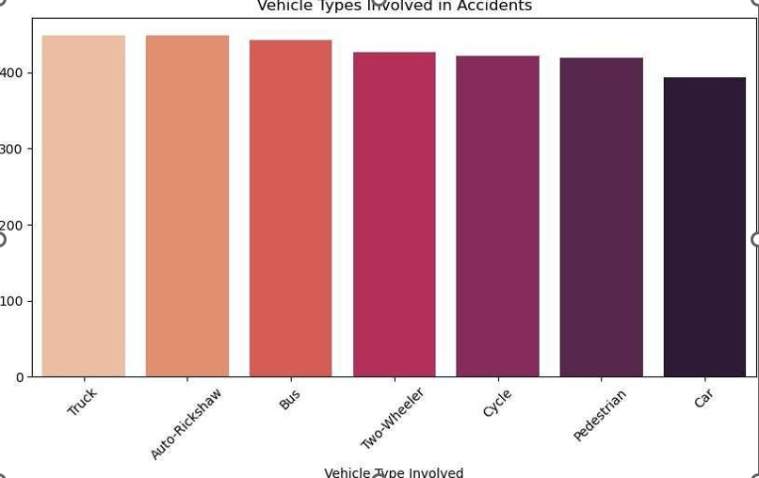
Distribution of Accident Severity
Accidents are classified as Non-Fatal (1524 cases) and Fatal (1476 cases).
Factors like Driver Age, Vehicle Type, Road & Weather Conditions impact severity levels.
Understanding severity aids in better accident prediction and prevention.
Vehicle Types Involved in Accidents
Trucks and Auto-Rickshaws are most frequently involved in accidents.
Buses contribute significantly, highlighting risks with heavy and public transport.
9

Slide 10
PREDICTIVE MODELLING
10

Slide 11
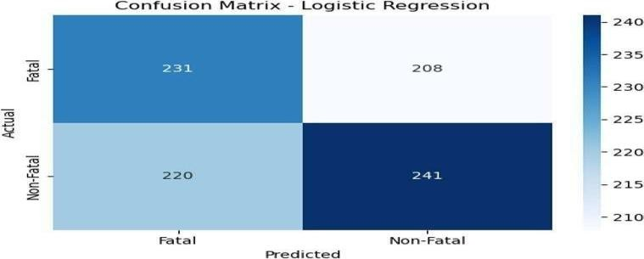
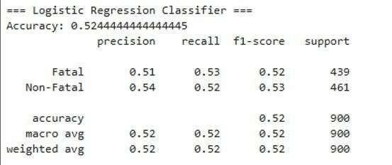
Model Evaluation
Logistic Regression: 52.44% accuracy with balanced performance across both fatal and non-fatal classes
The model shows balanced performance across both classes but lacks strong predictive power.

Slide 12
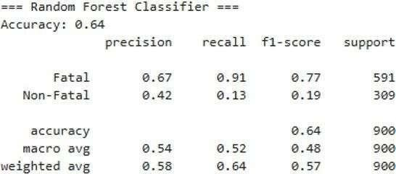
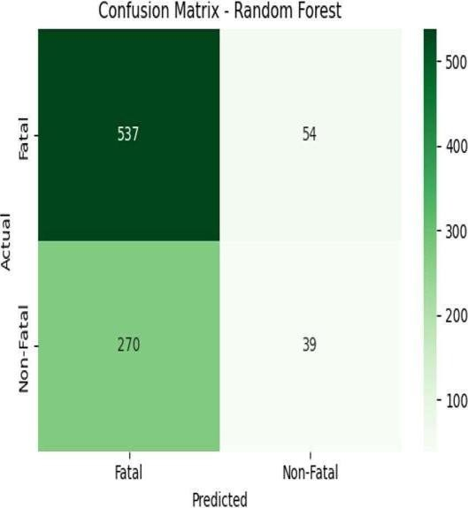
Random Forest: 64% overall accuracy with 91% recall for fatal accidents, but poor performance on non-fatal class prediction
Confusion Matrix shows 537 Fatal cases correctly predicted, but only 39 correct Non-Fatal predictions.
Model is highly effective for identifying Fatal accidents, but struggles with Non-Fatal due to class imbalance.
12

Slide 13
Results and Interpretation
The Logistic Regression model achieved an overall accuracy of 52.44%, showing balanced but moderate performance in predicting Fatal and Non-Fatal accidents.
The Random Forest Classifier performed better with an accuracy of 64%. It showed a high Recall of 91% and F1-Score of 0.77 for Fatal accidents, indicating its strength in detecting serious cases.
However, Random Forest struggled in predicting Non-Fatal cases due to class imbalance, making its predictions for this category less reliable. Despite this, it is preferred where identifying Fatal accidents is more critical.
Feature Importance analysis revealed Speed Limit, Driver Age, Road Conditions, and Alcohol Involvement as major factors influencing accident severity.
13

Slide 14
Conclusion
This project analyzed Indian road accident data to identify key factors affecting accident severity using statistical analysis and machine learning.
Random Forest Classifier outperformed Logistic Regression with better accuracy and higher recall for Fatal accidents.
Factors like Speed Limit, Driver Age, Vehicle Involvement, and Road Conditions were found to be major contributors to accident outcomes.
The findings can help traffic authorities focus on high-risk areas and implement targeted safety measures to reduce accident severity.
14

Slide 15
References
Kaggle Dataset: Source of raw data used for analysis and modeling. https://www.kaggle.com
Scikit-learn: Machine Learning in Python, Pedregosa et al., Journal of Machine Learning Research, 2011. https://scikit-learn.org/stable/
Pandas: Powerful Python data analysis toolkit, The Pandas Development Team. https://pandas.pydata.org/
Matplotlib: Visualization with Python, Hunter, J. D., Computing in Science & Engineering, 2007. https://matplotlib.org/
Seaborn: Statistical Data Visualization, Waskom, M., Journal of Open Source Software, 2021. https://seaborn.pydata.org/
15

Slide 16
THANK YOU
16

